Slide 1
output
layer norm
+
feed-forward
Transformer
layer
layer norm
+
feed-forward
multi-headed attention
input

Slide 2
output
layer norm
+
adapter
feed-forward
layer norm
+
adapter
feed-forward
multi-headed attention
input

Slide 3
bottleneck design
output
layer norm
adapter output
+
+
adapter
feed-forward
up-project
feed-forward
layer norm
non-linear
+
adapter
feed-forward
down-project
feed-forward
multi-headed attention
feed-forward output
input

Slide 4
output
layer norm
adapter output
+
+
adapter
feed-forward
up-project
feed-forward
layer norm
non-linear
+
adapter
feed-forward
down-project
feed-forward
multi-headed attention
feed-forward output
input

Slide 5
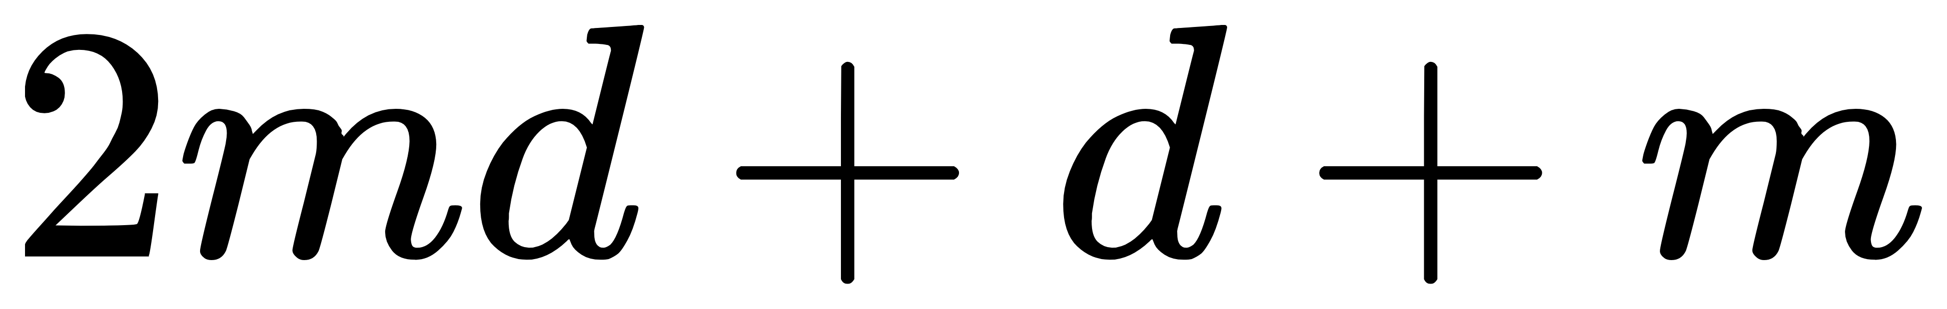

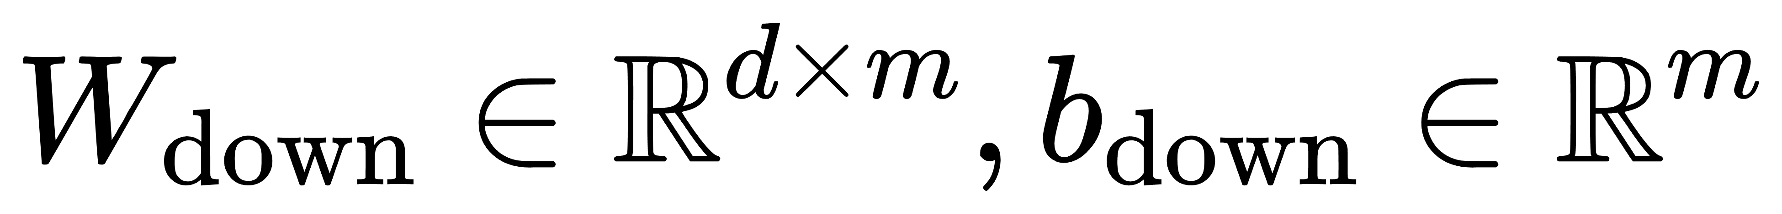
adapter output
+
feed-forward
up-project
non-linear
feed-forward
down-project
feed-forward output

Slide 6
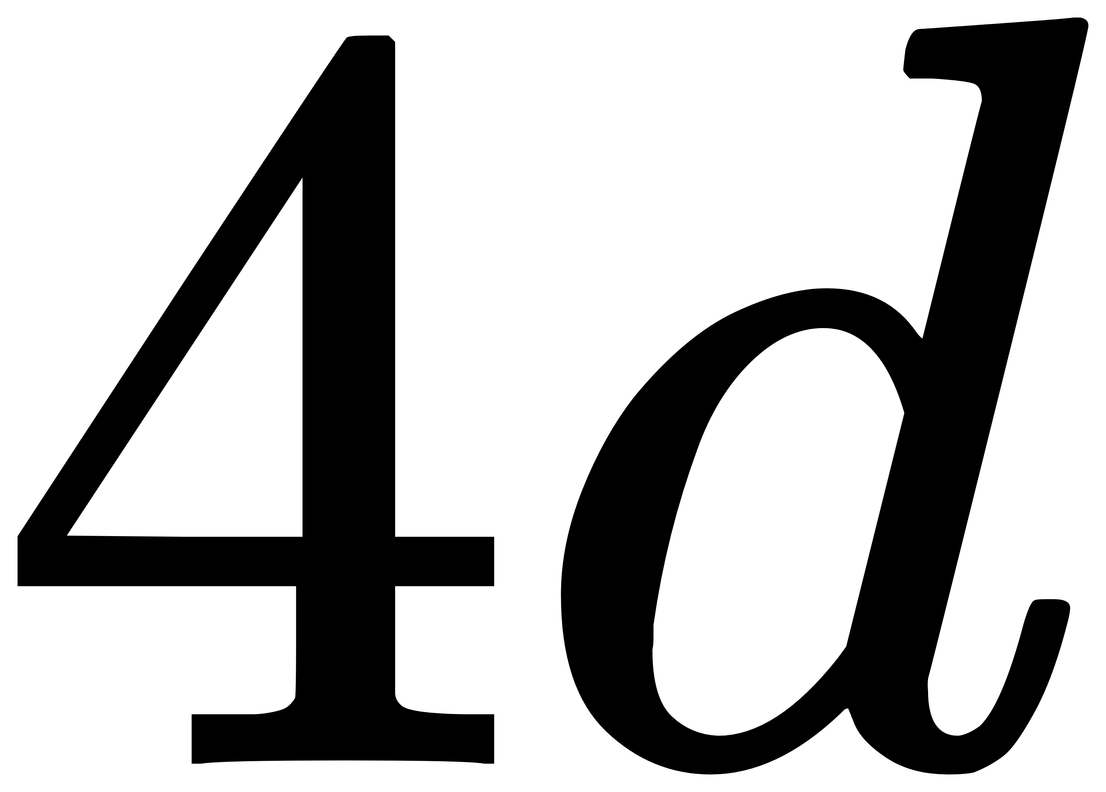
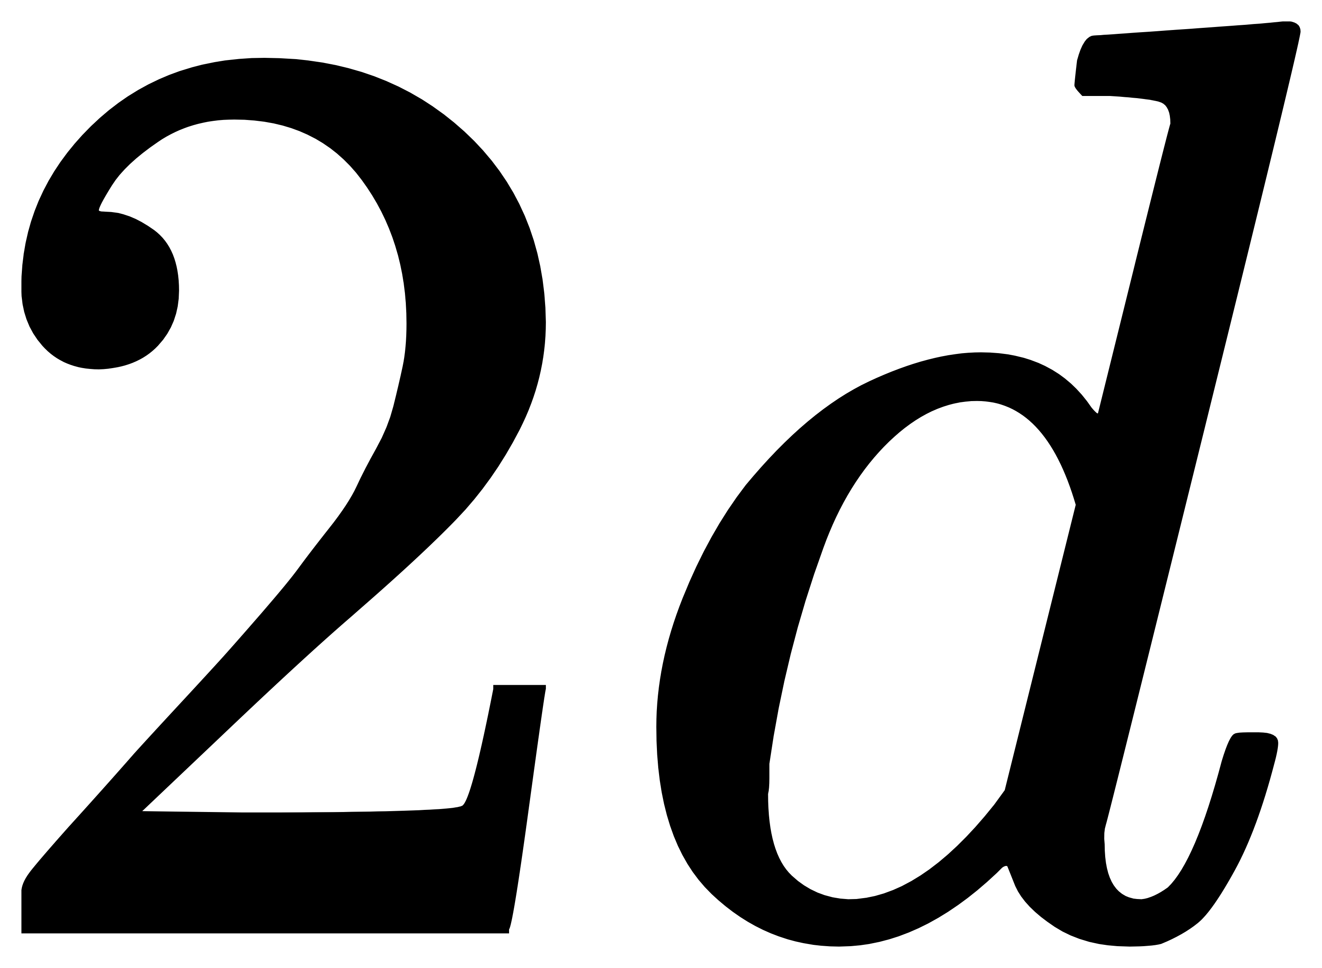
output
layer norm
adapter output
+
+
adapter
feed-forward
up-project
feed-forward
layer norm
non-linear
+
adapter
feed-forward
down-project
feed-forward
multi-headed attention
feed-forward output
input

